Slide 1
Music Emotion Recognition
Group 12
E/17/040 : Chandrasena M.M.D.
E/17/356 : Upekha H.P.S.
E/17/407 : Wijesooriya H.D.

Slide 2
Introduction
What is Music Emotion Recognition
Recognize the emotion that music expresses.
Extract and analyze music features, and map the relations between music features and the emotion space.
Importance of Music Emotion Recognition
MER has an enormous significance in real world applications such as,
Music recommendation
Music therapy
Music data management

Slide 3
MER Methods
Music Emotion Recognition
Static
Dynamic
Song level MER
Assign overall emotion label
Music emotion variation detection (MEVD)
Consider emotion in music as a changing process

Slide 4
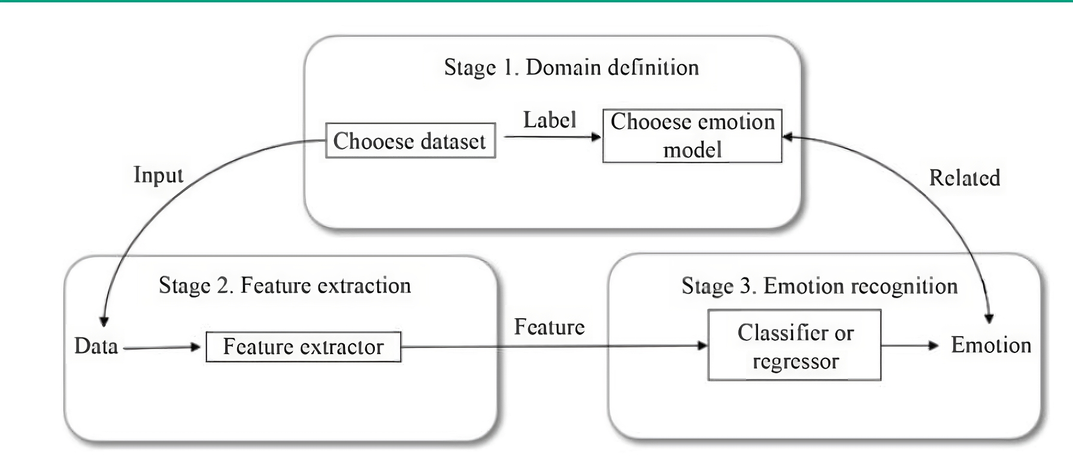
MER Framework

Slide 5
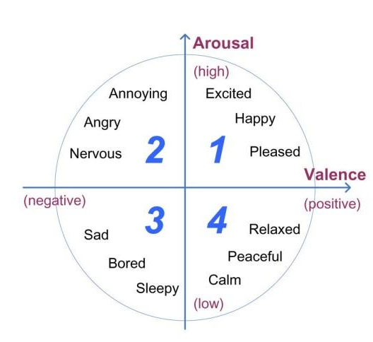
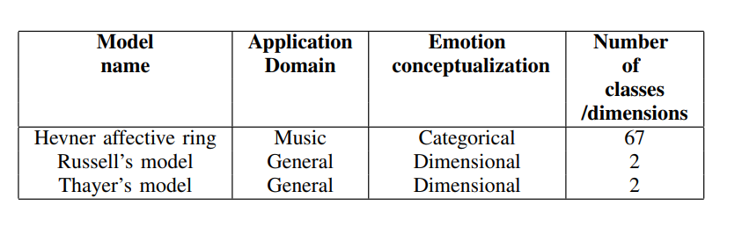
Emotion Models
Thayer’s arousal-valence plane

Slide 6
Research Problem and Objectives
Problem:
How to improve the accuracy of MER systems?
Objectives:
Identifying the drawbacks of existing systems
Implementing a dynamic MER system using DNN concepts with high accuracy
Implementing UIs to continuously monitor the emotion change in a given music sample

Slide 7
Proposed Methodology
openSMILE
Features
Feature Selection
Raw Audio Signal
BiLSTM
DNN
Output Targets
(Dynamic
AV values)
Emotion
Thayer’s Model

Slide 8
Experiments
and
Findings

Slide 9
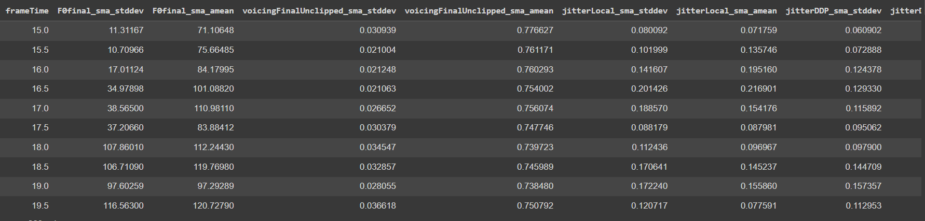
Dataset
MediaEval Dataset for Emotional Analysis in Music - DEAM dataset
Obtained from Kaggel https://www.kaggle.com/datasets/imsparsh/deam-mediaeval-dataset-emotional-analysis-in-music
1802 songs - annotated with both arousal and valence values for every 0.5s
Feature variables = 260
Target variables = 2 (Arousal and Valence)
Number of data points = 106132

Slide 10
Baseline, Reference and Proposed Model
Model | Parameters
Linear Regression (baseline model) | Folds = 5
SVR | Folds = 5
BiLSTM (reference model) | Folds = 5, Learning Rate=0.001, Epochs=25, Batch Size=32, Optimizer=Adam, Activation Function=relu
BiLSTM + DNN (proposed model) | Folds = 5, Learning Rate=0.001, Epochs=25, Batch Size=32, Optimizer=Adam, Activation Function=relu, Dense Layer Units=512

Slide 11
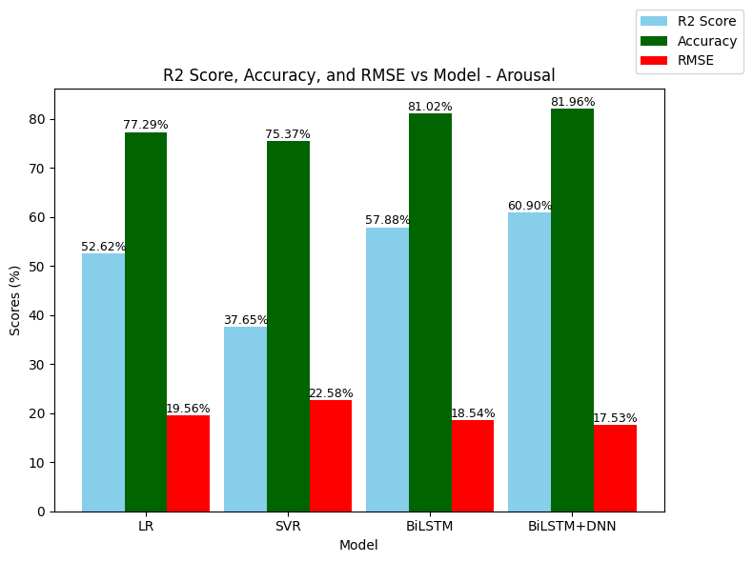
Model Comparison - Arousal
Score | Improvement
R2 Score | 15.08%
Accuracy | 6.04%
RMSE | 10.38%

Slide 12
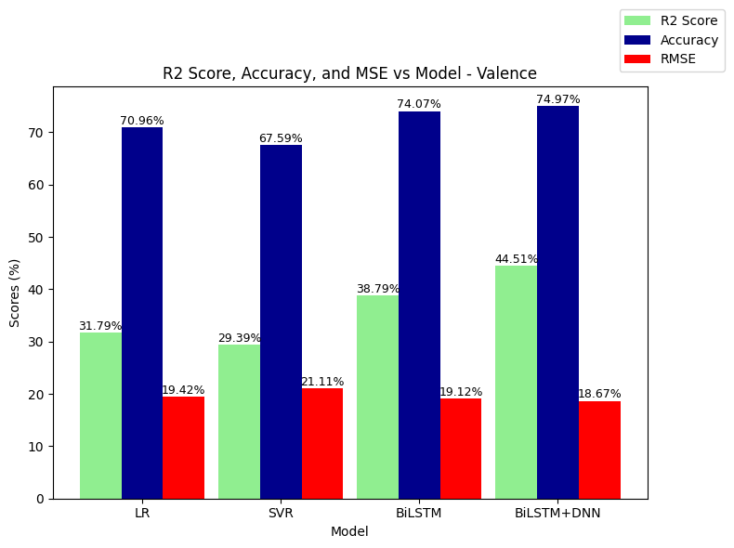
Model Comparison - Valence
Score | Improvement
R2 Score | 40.01%
Accuracy | 5.65%
RMSE | 3.86%

Slide 13
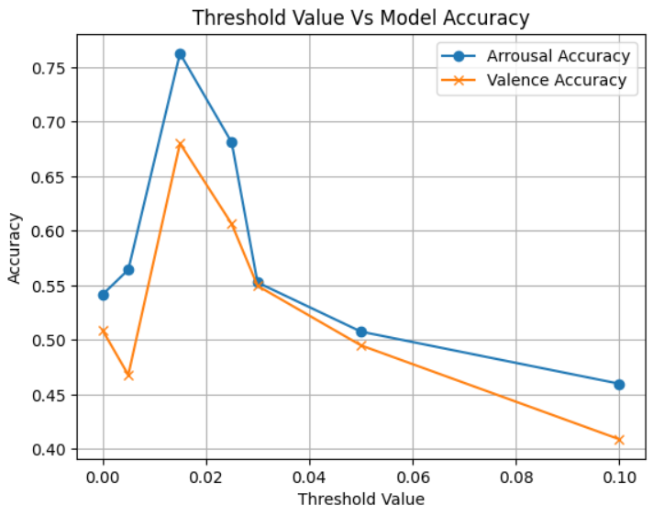
Feature Selection - CFS Method
Selected Threshold value : 0.015

Slide 14
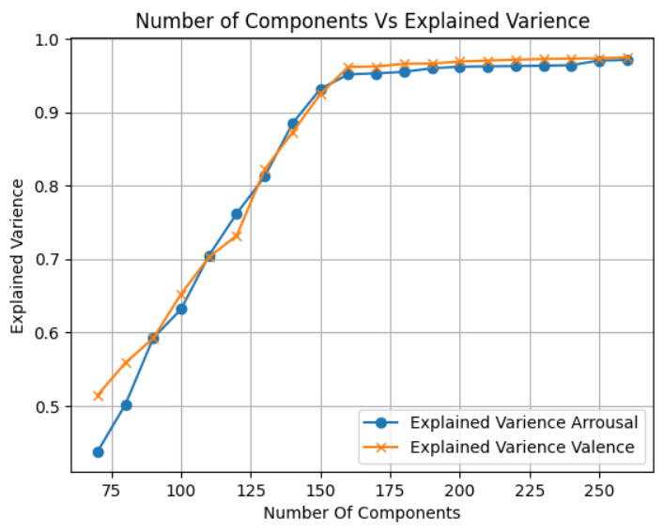
Feature Selection - PCA Method
Optimum number of Components : 160

Slide 15
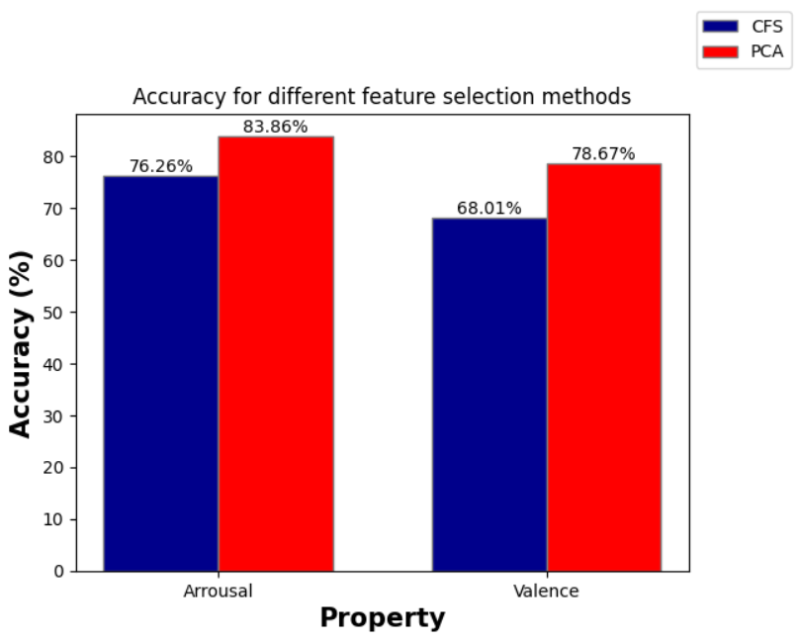
Comparison of Accuracies of Feature Selection
Arousal Accuracy Comparison
9.97%
Valence Comparison
15.67%

Slide 16
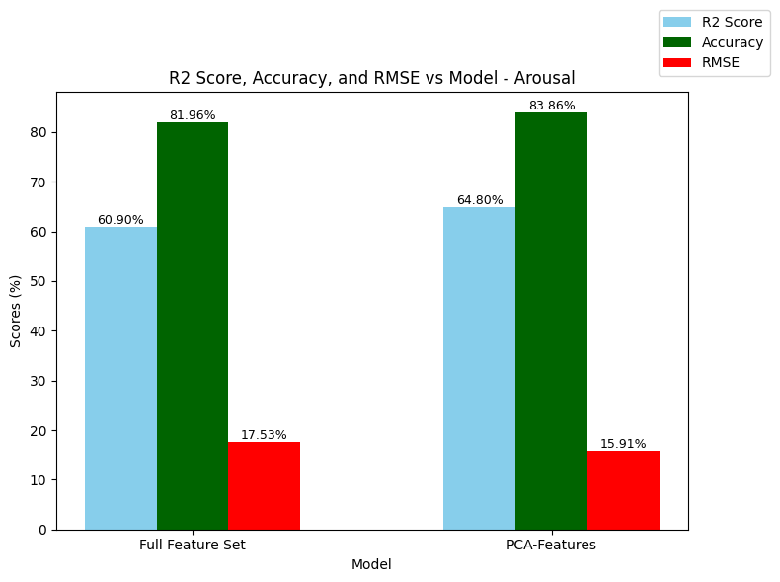
Model Accuracies for Full Feature Set and PCA Features
Score | Improvement
R2 Score | 6.40%
Accuracy | 2.37%
RMSE | 9.24%

Slide 17
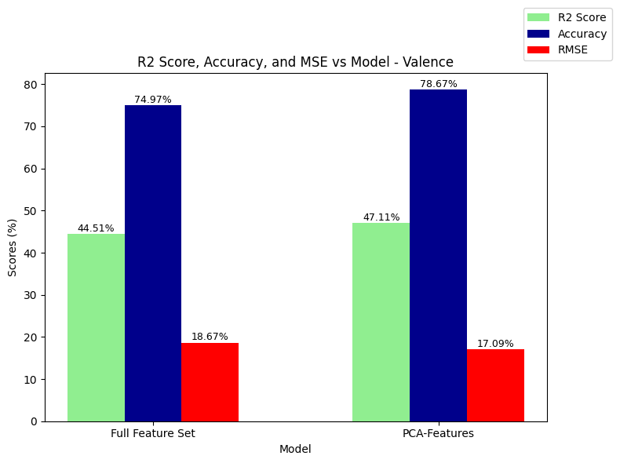
Model Accuracies for Full Feature Set and PCA Features
Score | Improvement
R2 Score | 5.84%
Accuracy | 4.94%
RMSE | 8.46%

Slide 18
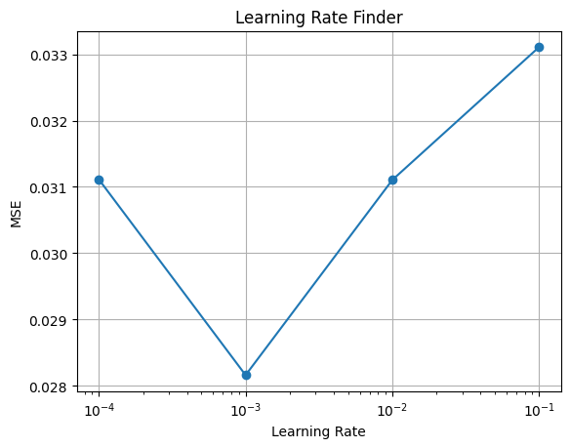
Parameter Tuning - Optimum Learning Rate

Slide 19
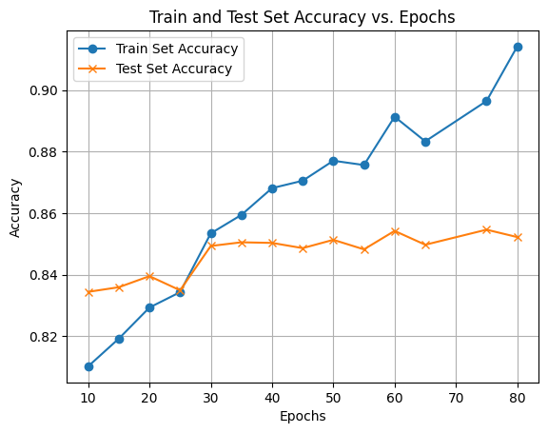
Parameter Tuning - Optimum Number of Epochs (Arousal)

Slide 20
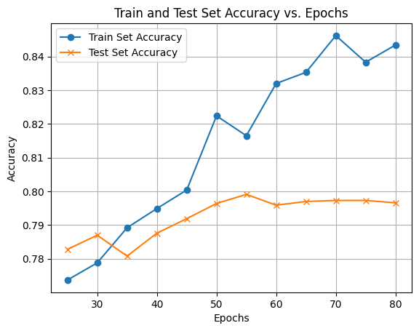
Parameter Tuning - Optimum Number of Epochs (Valence)

Slide 21
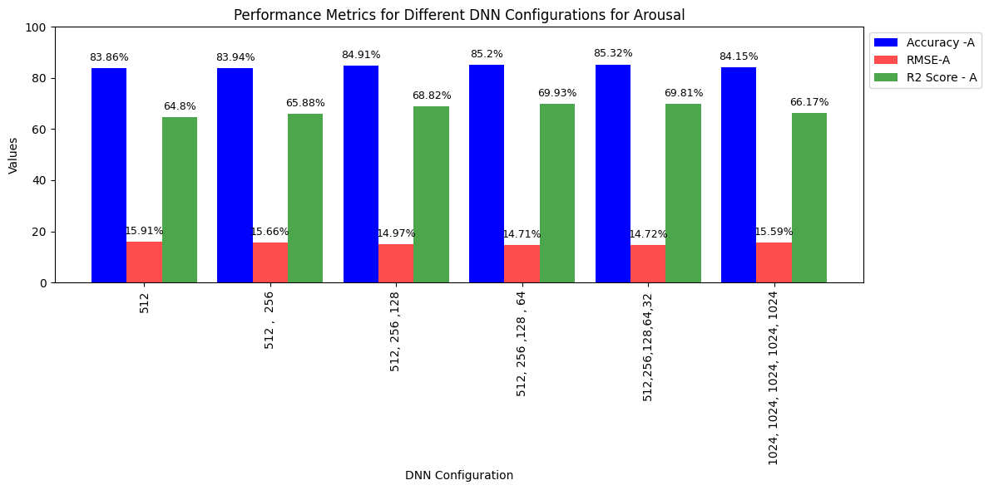
Different DNN layer combinations - Arousal
Score Improvement Accuracy - 1.74%
R2 Score - 7.73%
RMSE - 2.01%

Slide 22
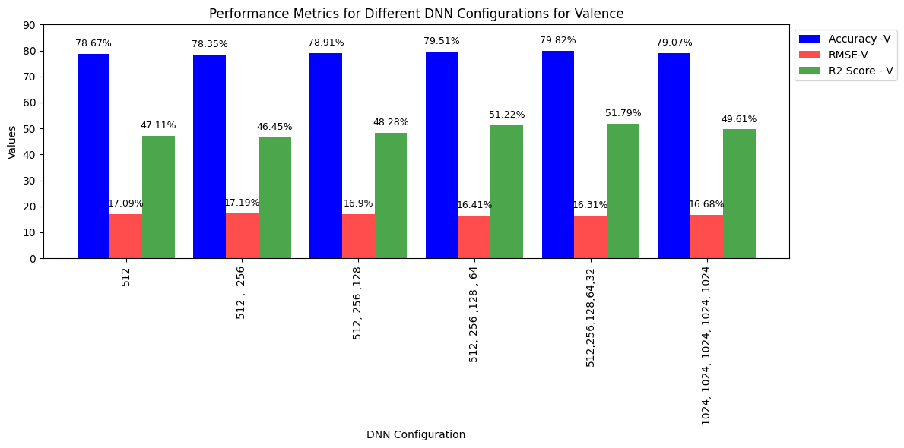
Different DNN layer combinations - Valence
Score Improvement Accuracy - 0.51%
R2 Score - 9.93%
RMSE - 4.56%

Slide 23
Selected Research Papers
[2] Kin Wai Cheuk, Yin-Jyun Luo, Balamurali B. T, Gemma Roig, and Dorien Herremans, ``Regression-based Music Emotion Prediction using Triplet Neural Networks'', November 2020.
[7] Ye Ma, XinXing Li, Mingxing Xu, Jia Jia and , Lianhong Cai, ``Multi-scale Context Based Attention for Dynamic Music Emotion Prediction'', October 2017.
[8] Haishu Xianyu, Xinxing Li, Wenxiao Chen, Fanhang Meng, Jiashen Tian, Mingxing Xu, and Lianhong Cai, ``SVR Based Double-scale Regression for Dynamic Emotion Prediction in Music '', 2016.
[9] Xinxing Li, Jiashen Tian, Mingxing Xu, Yishuang Ning, and Lianhong Cai,``DBLSTM - Based Multi-scale Fusion for Dynamic Emotion Prediction in Music ''.
[10] Xinxing Li, Haishu Xianyu, Jiashen Tian,Wenxiao Chen, Fanhang Meng, Mingxing Xu, and Lianhong Cai, ``A Deep Bidirectional Long Short-Term Memory Based Multi-scale Approach for Music Dynamic Emotion Prediction '', 2016.
[11] Yu Xia and Fumei Xu, ``Study on Music Emotion Recognition Based on the Machine
Learning Model Clustering Algorithm'', October 2022.

Slide 24
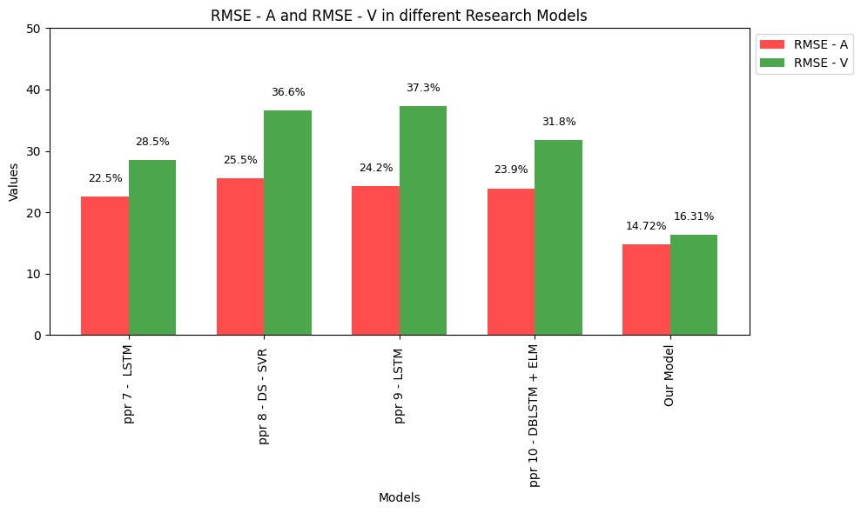
Best Model Developed Vs Existing Models (RMSE)
Score | Reduction
RMSE - A | 34.57 %
RMSE - V | 42.77 %

Slide 25
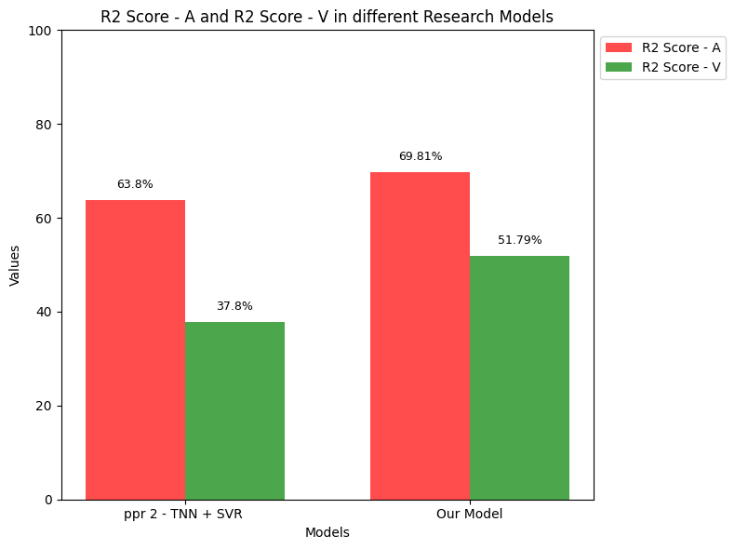
Best Model Developed Vs Existing Models (R2 Score)
Score | Improvement
R2 Score - A | 9.42 %
R2 Score - V | 37.01 %

Slide 26
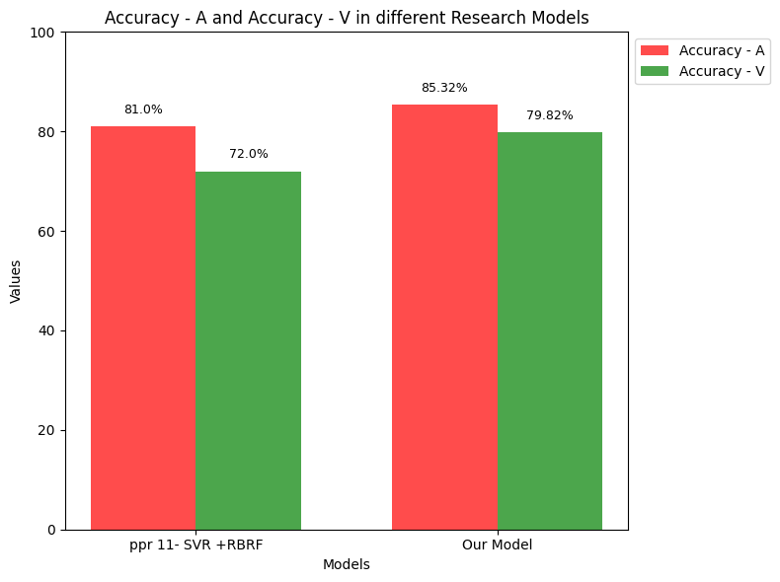
Best Model Developed Vs Existing Models (Accuracy)
Score | Improvement
Accuracy - A | 5.33 %
Accuracy - V | 10.86 %

Slide 27
Findings…
Systems that use DNN, have a higher accuracy compared to the systems that use only the traditional machine learning algorithms.
Dynamic MER models are more accurate than the static MER models.
The systems that have used hybrid models rather than a single model display more accuracy.

Slide 28
Problems Encountered and How they were handled ….

Slide 29
Problems and Solutions
Challenges we faced | things we did
It consumes 7min/epoch when using LSTM | using CuDNNLSTM
GPU limitations in Google Colab free edition | Running codes in the department server ‘Turing’
Department server ‘Turing’ becomes slow when multiple clients use it | Using Google Colab Running our codes when no other one is connected to it.

Slide 30
Plan
Expected Outcomes
& their Impact

Slide 31
Plan
Week 1-2
Week 3 - 4
Week 5 - 6
Week 7 -8
Extracting music features, Adding more units to DNN layer, Running scripts on department server.
Implementing Baseline and reference model, and parameter tuning
Try different feature selection methods and adding DNN to the reference model
Finding optimum learning rate, number of epochs, adding more DNN layers and testing the model performance.
Week 9 - 10
Week 10 - 12
Week 13 - 14
Week 15 - 16
Further Improvements in the developed model
Web application development
System Integration Deployment
Result documentation and reporting

Slide 32
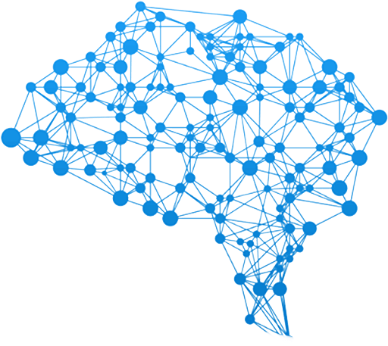

Expected Outcomes & Their impact
MER System
Web Application
Impacts :
Enhanced Music Understanding
Improved Music Recommendation Systems
Music Therapy

Slide 33
THANK YOU

